Slide 1
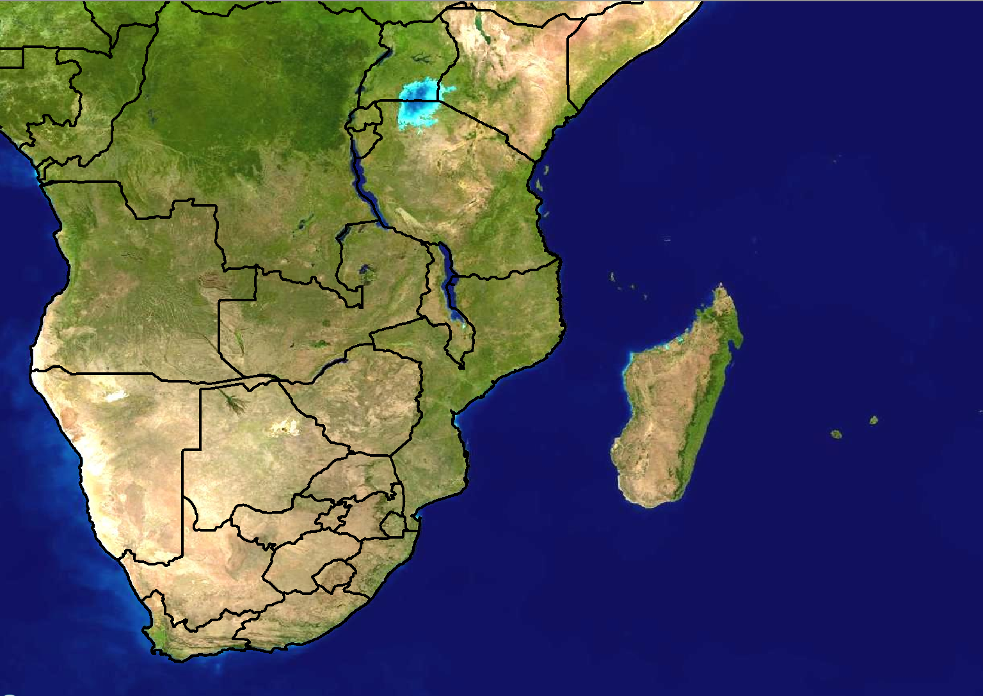
Scenario 1: Forecast for Day 3
24 hour rainfall (mm)
>100
80-100
60-80
40-60
20-40
Forecast issued:
Monday 20 February
Forecast valid:
Wednesday 23 February

Slide 2
Scenario 1 - Additional information:
A cut-off low (COL) pressure is expected to be situated over the western interior of South Africa on Wednesday.
It is not a very strong system, but the models are showing high rainfall amounts over the central interior of South Africa.
There is a local soccer match between Bloemfontein Celtic and Black Aces that is expected to take place at the Free State Stadium (Toyota Stadium), Bloemfontein on Wednesday evening.

Slide 3
Scenario 2: Forecast for Day 1 (Today)
24 hour rainfall (mm)
>100
80-100
60-80
40-60
20-40
Forecast issued:
Wednesday 23 February Forecast valid:
Wednesday 23 February

Slide 4
Scenario 2 - Additional information:
The COL has weakened from what was expected, but very high rainfall amounts are still expected over the central interior of South Africa
Models are in agreement with the placing of the 24hour rainfall amounts of 40-60mm.
The Unified Model (12km) shows 6 hourly rainfall amounts of >100mm between 06-12Z over the western Free State while ECMWF shows 60mm over the central Free State this evening, between 18Z-24Z.
24 hour rainfall totals recorded until 06Z today:
Kimberley - 42mm
Upington - 20mm
Fauresmith - 52mm
Kuruman - 48mm

